Slide 1
JJAX AN NFT Based Music Sharing Platform
Group 12 – Andrew McWilliam, Jake Grieves, Jaiyi Zhong and Xinrui Hue

Slide 2

Intro
Topic one
Topic two
Topic three
Topic four

Slide 3

Introduction
Modern technology has revolutionised the streaming, distribution and sale of music, making it easier and more efficient than ever before.
And yet these developments have brought with them their own unique set of challenges – lack of platform transparency, lack of artist autonomy and high barriers to entry in the form of fees and restrictions.
Is there an overarching source to these problems, are these challenges symptoms of a wider issue?
Notes:
The advent of music streaming platforms revolutionised music consumption but also introduced problems like high fees, restricted content access, and challenges for non-mainstream creators. To address these, the report discusses the development of a decentralized streaming music platform, JJAX, built on Ethereum, leveraging smart contracts, tokenization, and NFTs. This platform ensures a more open, transparent, and fair revenue sharing environment for creators. They can freely upload music, set their own prices, and receive most of their earnings in cryptocurrency. The platform also encourages secondary creators to remix and upload their creations, ensuring original creators also profit. Listeners can discover and purchase music at a lower cost. The report outlines the background, motivation, architecture, and technical details of JJAX, evaluates its effectiveness, and discusses potential improvements. In essence, JJAX is poised to disrupt the industry, providing a fairer, more sustainable model for music consumption

Slide 4
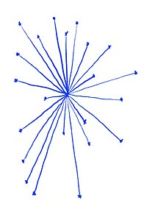
Centralisation

Slide 5
Market Research

Slide 6
Problems with Web 2.0 streaming & distribution
Lack of transparency: The entities controlling these services hold most of the information about revenue generation and distribution, making it hard for artists to verify whether they're receiving a fair share.
Limited control for artists: With control concentrated in the hands of a few, artists often have little say over their work's distribution, including how it's used and priced.
High barriers to entry: Centralised services often impose high costs and strict requirements, making it challenging for emerging artists to join these platforms.

Slide 7
Our Idea
Our decentralised streaming music platform JJAX attempts to solve these problems through the application of blockchain technology.
JJAX offers a fairer and more transparent revenue sharing system. Providing free music file uploading services, enabling original creators to upload their music to our platform, set their own prices, and receive the majority of their earnings in cryptocurrency when other users purchase their music
Built on Ethereum, using smart contracts, tokenisation and NFTs to provide a more open and transparent environment for all users.

Slide 8

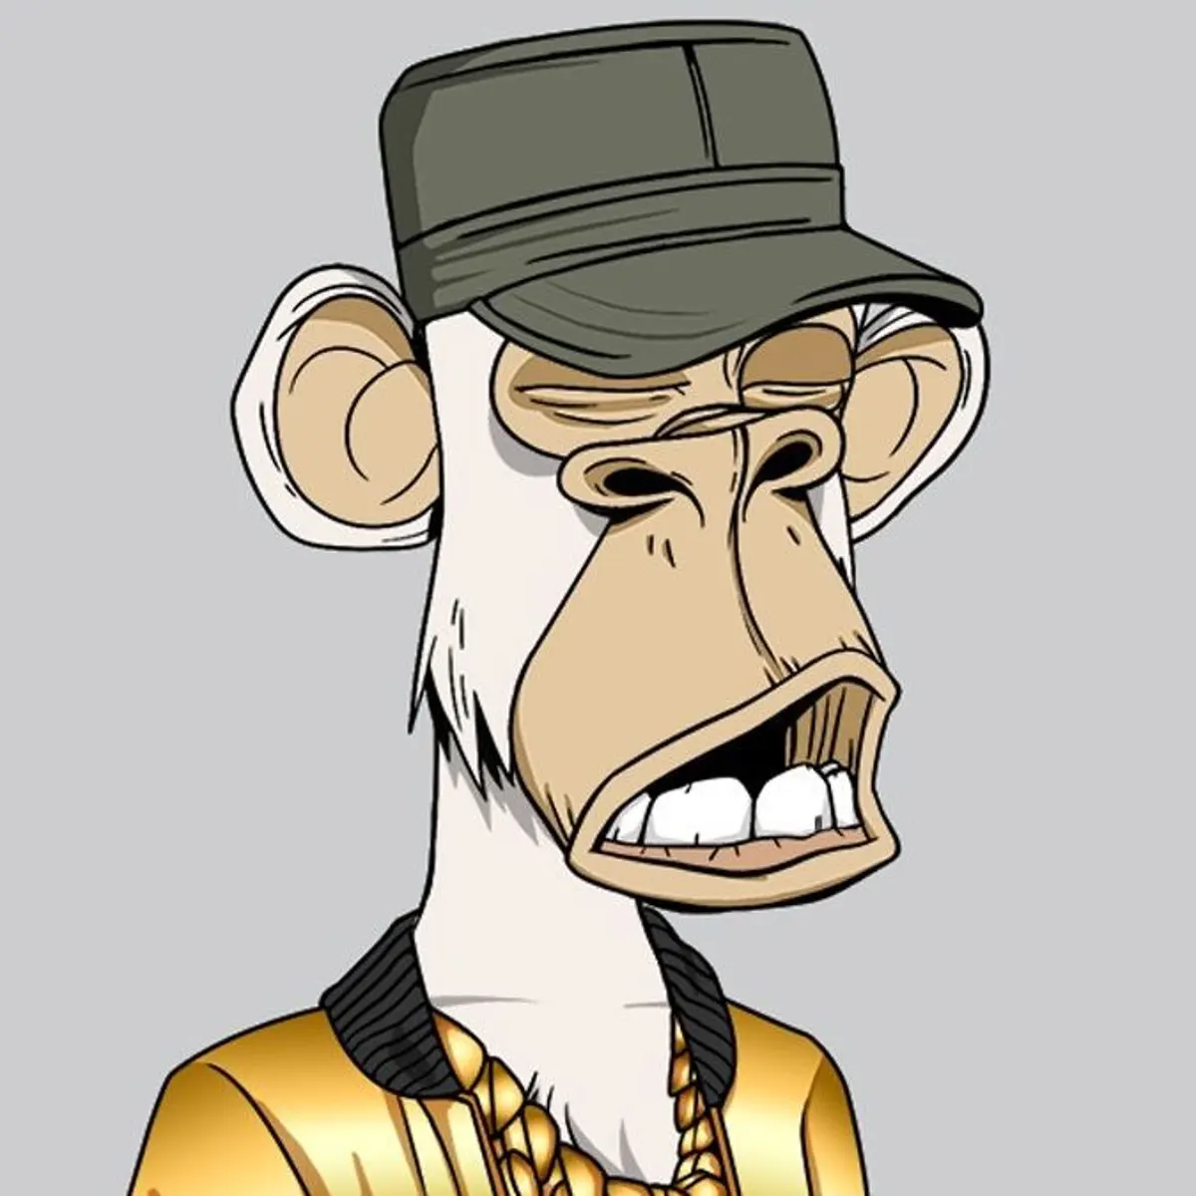

Background Technology
The project is heavily based on the ERC 721 “Non-Fungible Token Standard”
OpenZeppelins’ implementation is used by the project through inheritance.
IPFS is used to host the song metadata

Slide 9
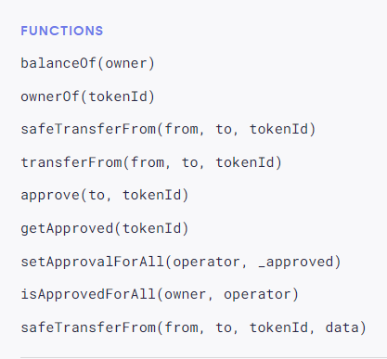
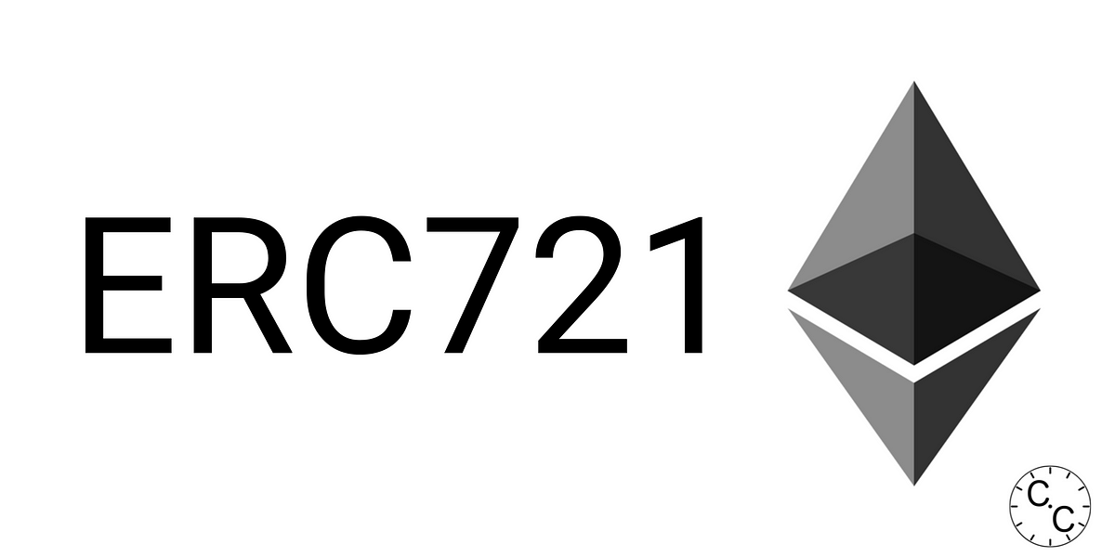
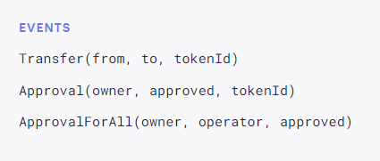
The “Non-Fungible Token Standard”
Inspired by the ERC 20 standard
provides basic functionality to track and transfer NFTs.
Shown are the requirements for an object to be ERC 721 Complacent

Slide 10
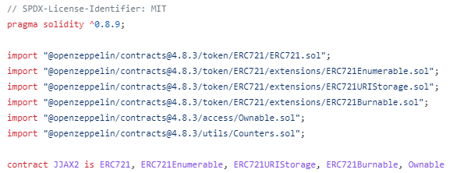
OpenZeppelin is an open-source framework and library for building secure and audited smart contracts on the Ethereum blockchain.
Contains an implementation of the ERC 721 standard (and extensions), which are used by the project.
The project makes use of five base contracts for added functionality.
ERC721.sol
Ownable.sol
Counters.sol
Enumerable.sol
URIStorage.sol
Burnable.sol

Slide 11


IPFS
“A peer-to-peer hypermedia protocol designed to preserve and grow humanity's knowledge by making the web upgradeable, resilient, and more open.”
Decentralised File Sharing Platform Perfect for our needs in the project.
Each piece of content is identified by a unique hash.
Third party applications are used to upload and view data.

Slide 12

Backend Design
JJAX’s backend architecture was designed in the aim of fulfilling the following objectives –
Enable users to mint their own Non-Fungible Tokens (NFTs)
- Of the ERC721 standard previously discussed.
Allow users to list an NFT in one of two ways –
- A fixed price listing, where the lister defines the minimum price they would be happy with exchanging the NFT they own
- An auction based listing of specified minimum starting price and period of activity, where during this period, other users can input bids in the aim of claiming ownership over the particular NFT.
Allow users to buy fixed priced listing and participate in active auctions.
Allow users to view current listings, separated by their distinct type.

Slide 13
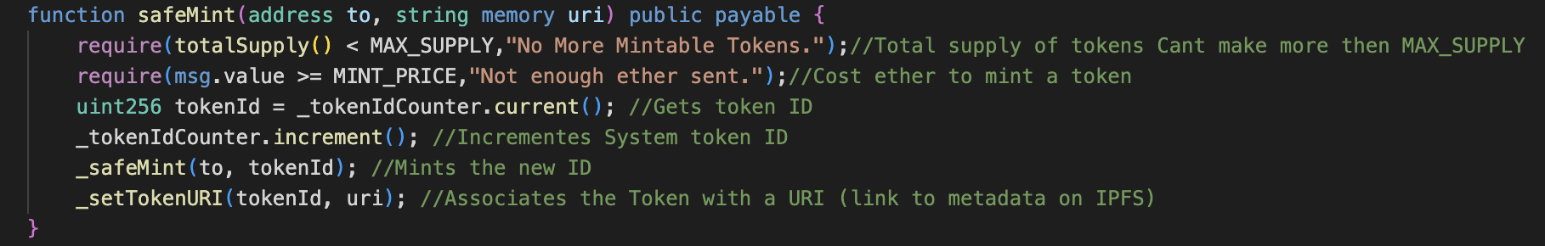
Backend Design, Initial Minting of NFT

Slide 14
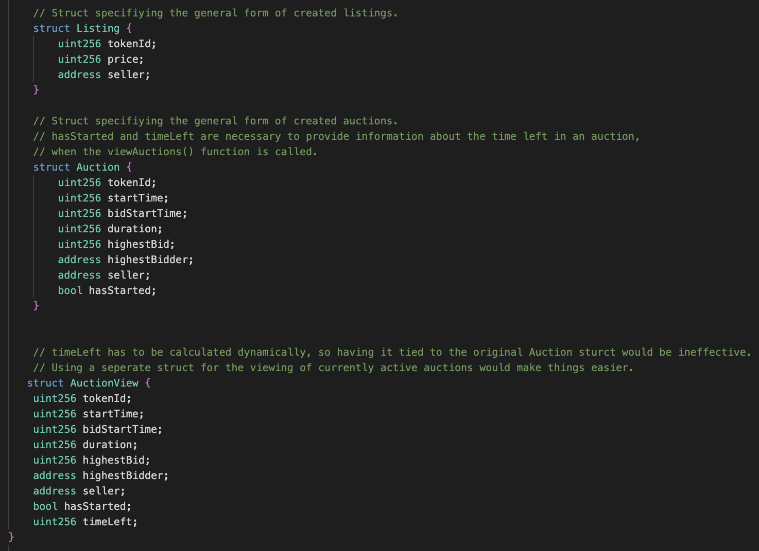
Backend Design, Structures
Each struct represents the general form of fixed price listings and auctions listings, while active, which are used to represent various types of information in a structured format:

Slide 15
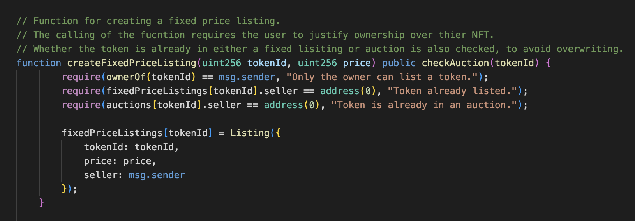
Backend Design, Creation of Fixed Price Listing

Slide 16
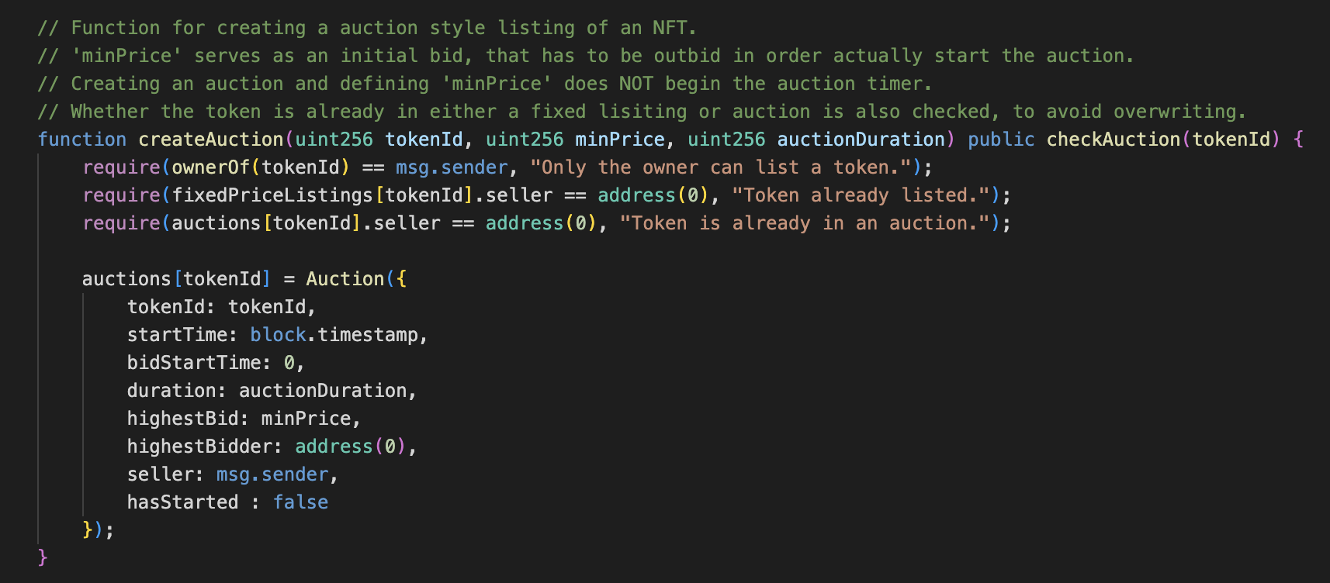
Backend Design, Creation of Auction Based Listing

Slide 17
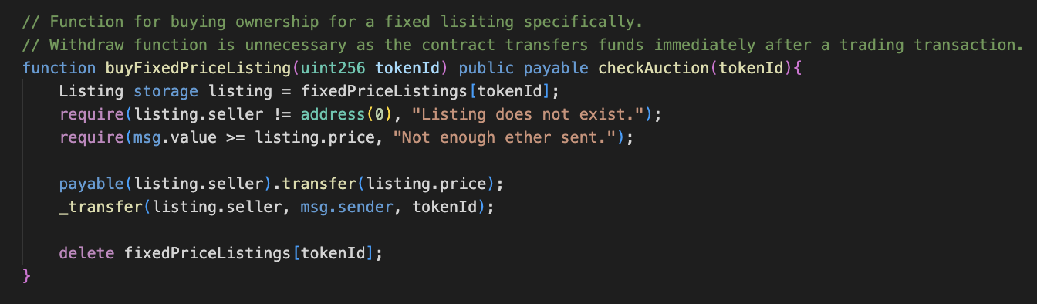
Backend Design, Buying a Fixed Price Listing

Slide 18
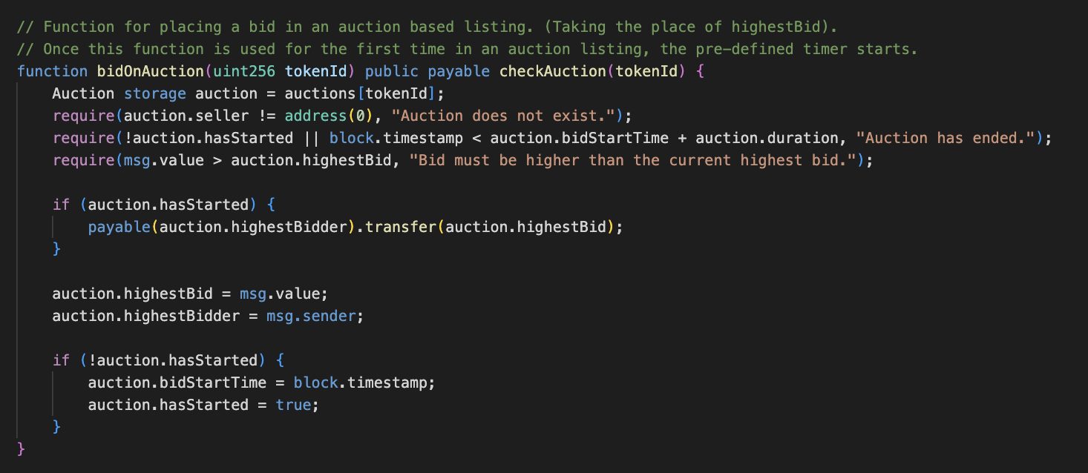
Backend Design, Buying a Auction Based Listing

Slide 19
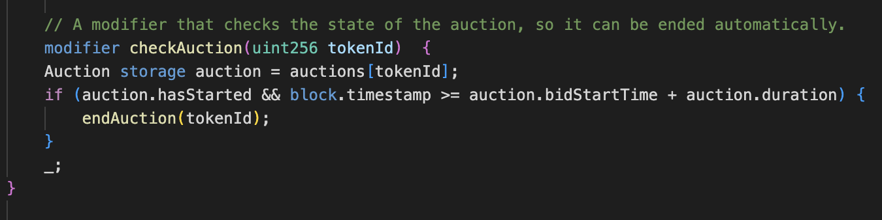
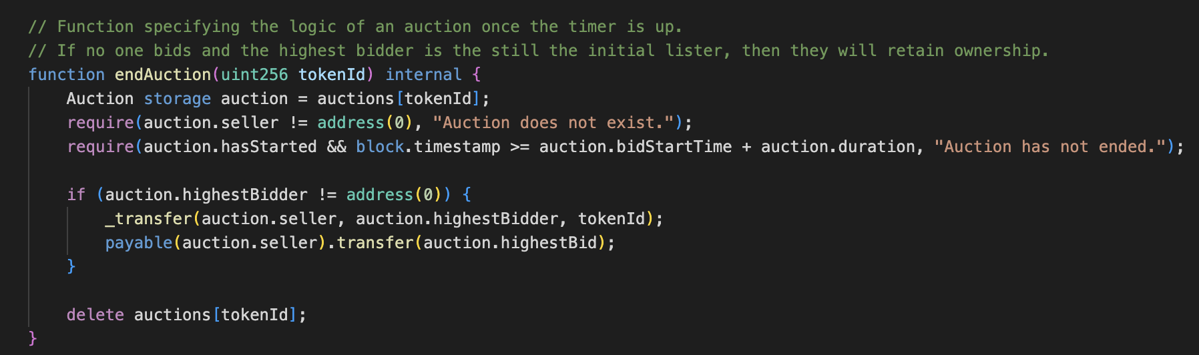
Backend Design, Mechanism for Concluding Auction

Slide 20
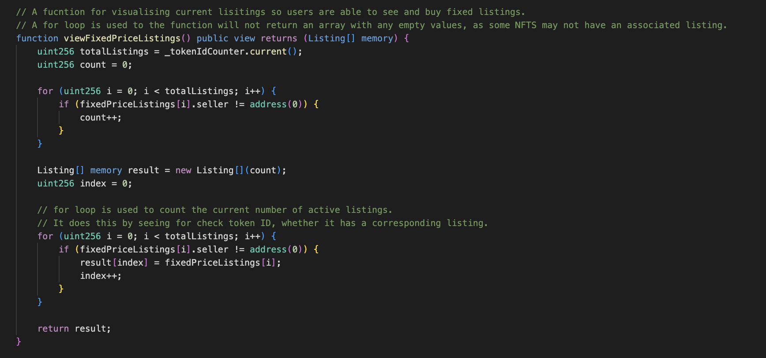
Backend Design, Presenting Active Fixed Price Listings

Slide 21
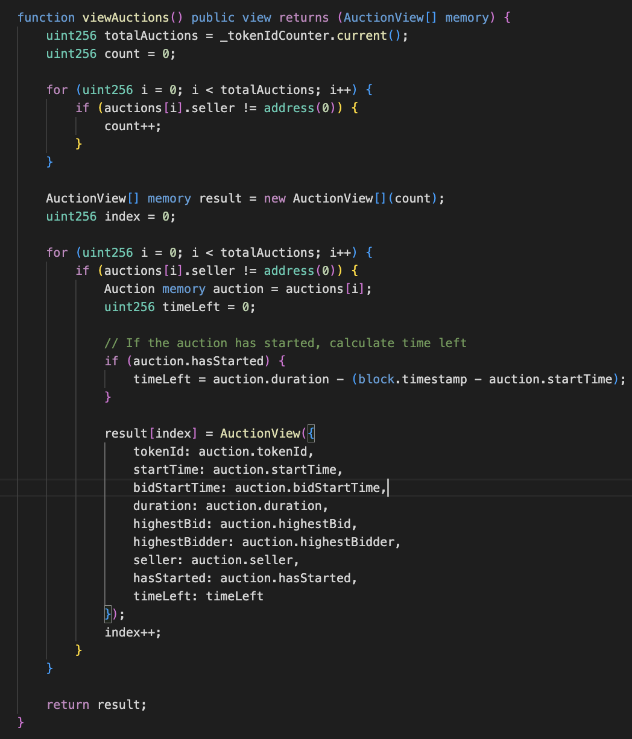
Backend Design, Presenting Active Auction Listings

Slide 22
Front End
Responsible for facilitating the backend through user enabled interactive functionality –
Allow users to upload their art or music, and upload their generated NFT to the network.
Facilitate the buying and transfer of NFTs, through making use of wallets with the MetaMask API.
Allowing the user to view NFTs under their associated address, as well as other active listings.

Slide 23
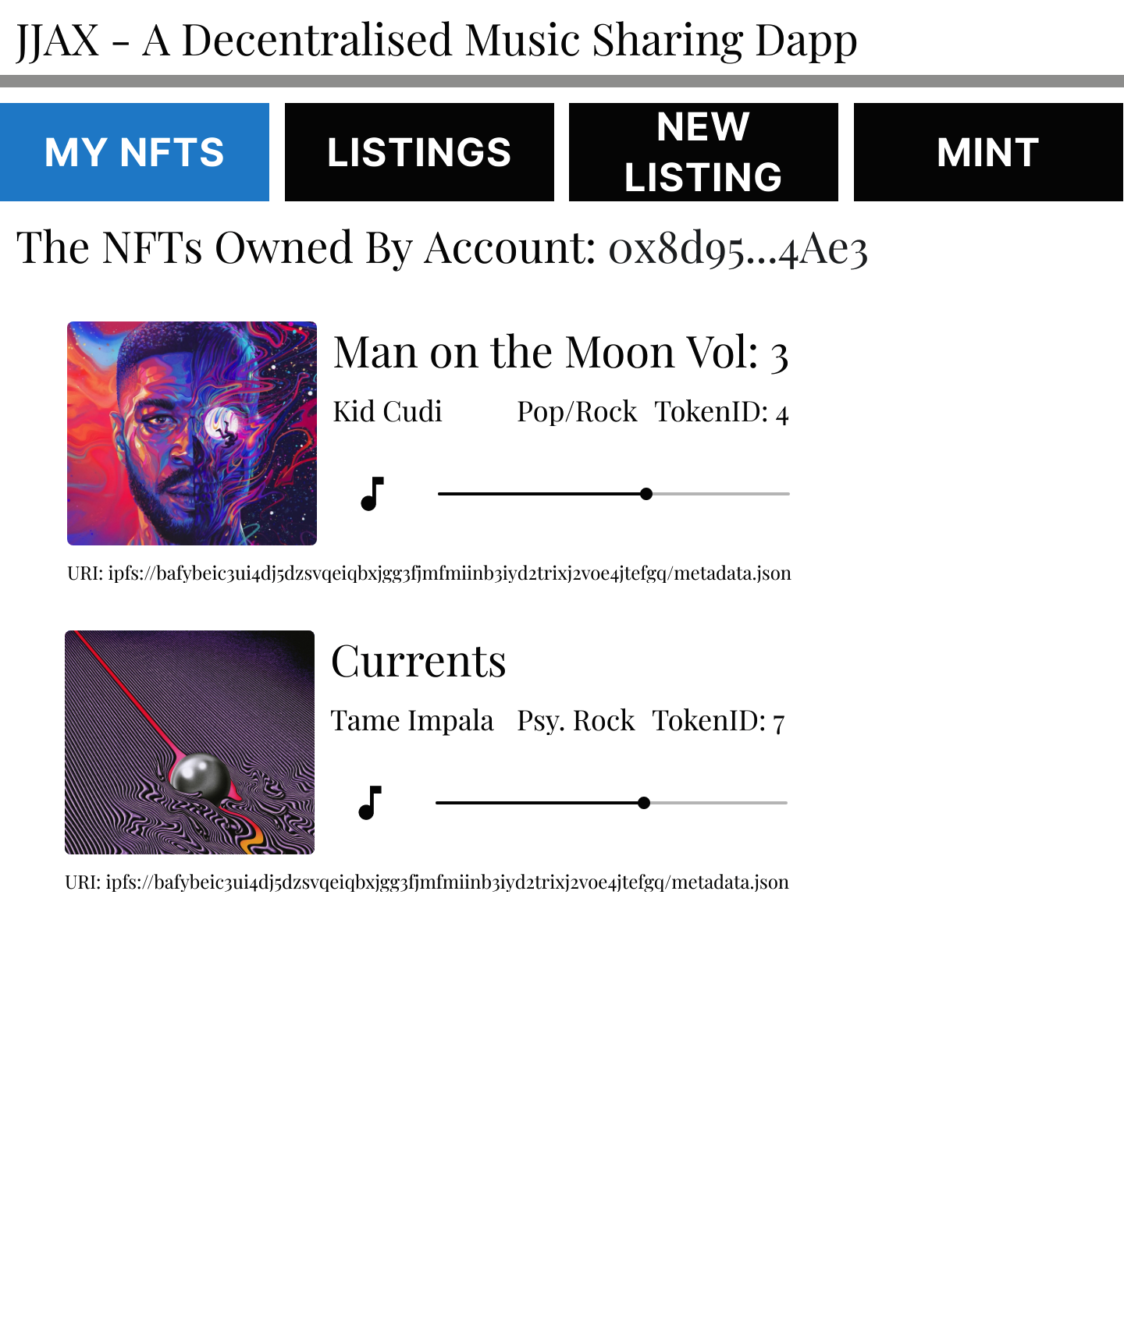
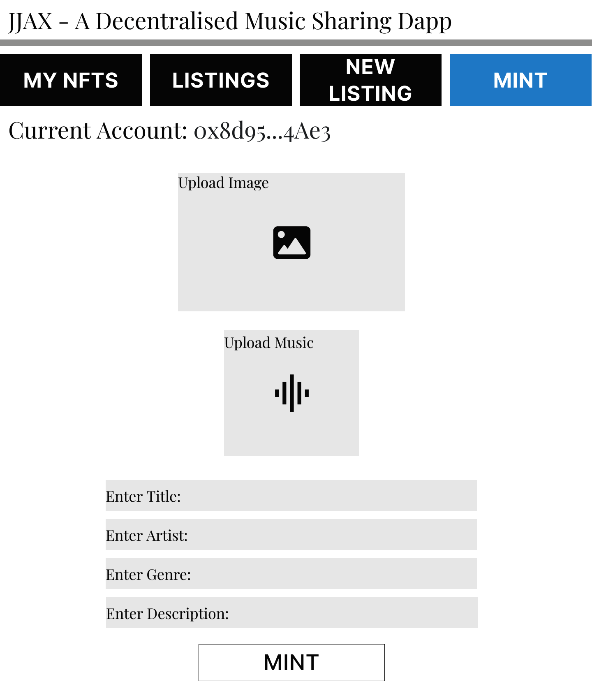
Front End Demo, Ownership & Minting

Slide 24
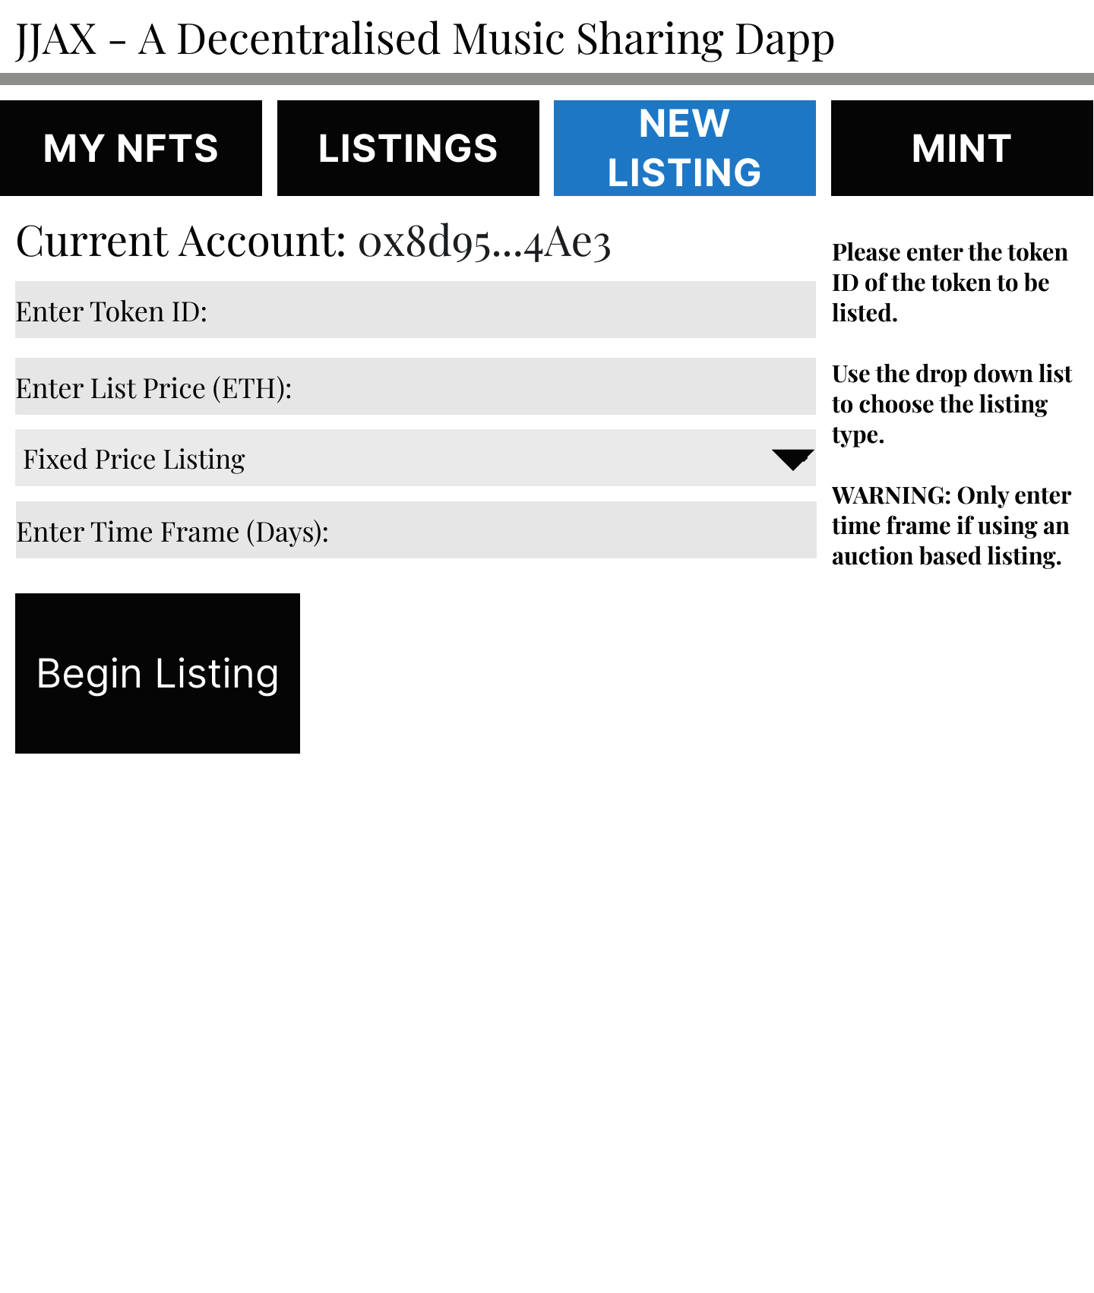
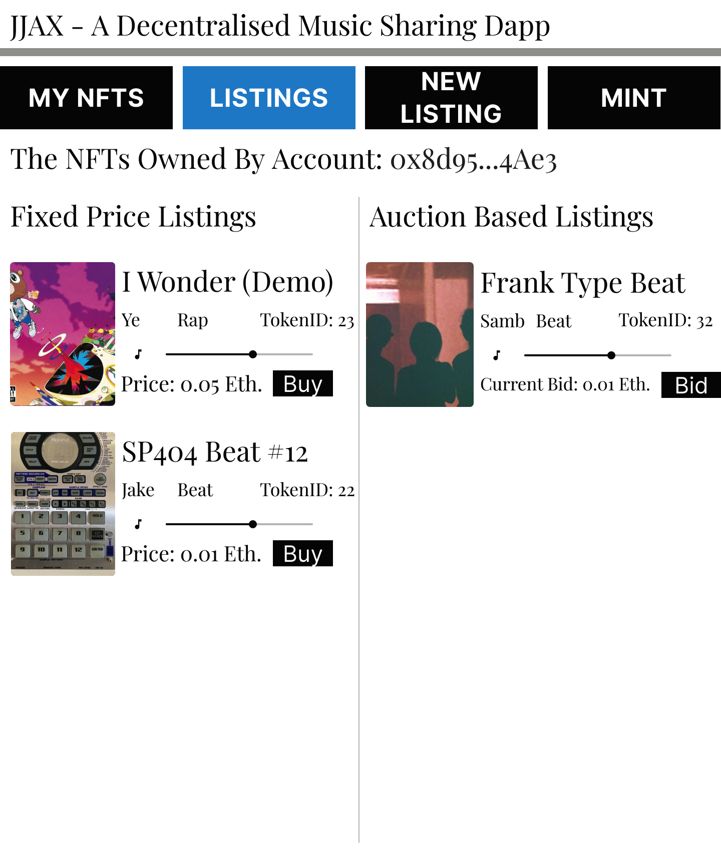
Front End Demo, Creating & Viewing Listings

Slide 25



Future Scope
Deployment to the Ethereum Mainnet
ERC 1150 Token Standard
An introduction of a governance structure.
Implemented fair streaming based compensation
OpenSea integration

Slide 26




Thank you

